Slide 1
Research Skills
The Front-End of Product Development as Systems Thinking and Predictive Learning
Procedia Manufacturing
Volume 39, 2019, 104460
Authors: Charles L.K Yamamura, Celma O. Ribeiro, Denise Dantas, Jose A. Quintanilha, Fernando T. Berssaneti
Citations: 1

Slide 2
Sections
Abstract
Introduction
Theoretical background
Conceptual definitions
Proposition and model
Simulation
Results
Conclusion

Slide 3
Abstract
The front-end of product development (the set of exploratory activities prior to project approval) is usually vague, unstructured, and based on heuristics.
New product decisions are made for the future: predictive knowledge should be extrapolated from current information
This paper proposes the front-end should be akin to a scientific inquiry, with systems thinking and predictive learning as mainstays to create customer value and reduce its “fuzziness”

Slide 4
Introduction
The front-end of product development (FEPD) comprises the activites preceding official approval and funding of a project – opportunity identification, idea generation and concept development.
Product strategy is usually performed based on heuristics and businesses struggle to keep track of knowledge and to use it effectively.
This paper investigates the FEPD as an asset of activities to create knowledge to understand and use to predict customer needs and aspirations, using systems thinking and data-based simulation.

Slide 5
Method
This study is grounded in literature review, theoretical model construction and simulation.
A central proposition was made and a theoretical model showing both conventional and systemic approaches were built. The usefulness of a theory is subsumed by its capacity to predict a behavior.
A computer experiment using an artificial neural network was conducted to simulate predictive learning in an automobile development case.

Slide 6

Theorical background
The expression fuzzy front end (FFE) was coined by Reinertsen in 1985
How to improve betting in project?
EV – expected value
p – probability of success
U – upside of success
Can increase by augmenting customer value (customer learning)
D – downside of failure
Reducing uncertainty, getting better information about possible outcomes from existing information

Slide 7
Theorical background
Companies tend to stick to traditional methods, such as internal data (e.g. sales reports), external reports (from consulting, technical associations etc.) (Geyer survey)
Most companies do not have a clear understanding of customer needs. However, success in the marketplace depends on how well the product concept matches customer value.
Jetter also remarked companies relied on guessing instead of structured methods for handling the fuzzy front-end. The author accentuates a product concept will affect future customer experience not only at a still coming launch time but till the end of its disposal (a time span of about twenty years for some products, like automobiles).

Slide 8
Conceptual definitions
System: Set of elements – products, people, information, knowledge and other assets
Theory: System of concepts integrated into propositions
System engineering: a logical way of thinking design, operate and manage the system.
Concept: formally defined data and mapping of arguments into values and functions
Proposition: explanation of concepts and how they are related
Information: interpreted data
Knowledge: information assimilated by person
Judgement: process of determining payoffs of decisions in particular situations.

Slide 9
Conceptual definitions
Prediction: rigorous extrapolation of new information from existing information
Simulation: technique for understanding and predicting the behaviour of a system
Learning: reduction in the gap between needed and available knowledge
Supervised statistical learning: building statistical models for prediction, based on examples
Value: capability to satisfy a stakeholder’s need, created by the interaction of system elements in addition to their individual contributions
Product development: process of transforming market and technology data into information that reduces uncertainty about customer needs, competition and technology, raising the likelihood of success

Slide 10
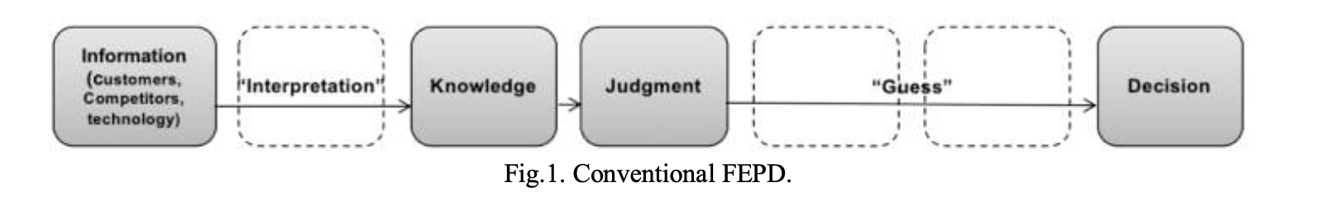
Proposition and model
Information: interpreted data. (gut feel)
Knowledge: information assimilated by person.
Judgement: process of determining payoffs of decisions in particular situations.
Decision: choice derived from a judgment.

Slide 11
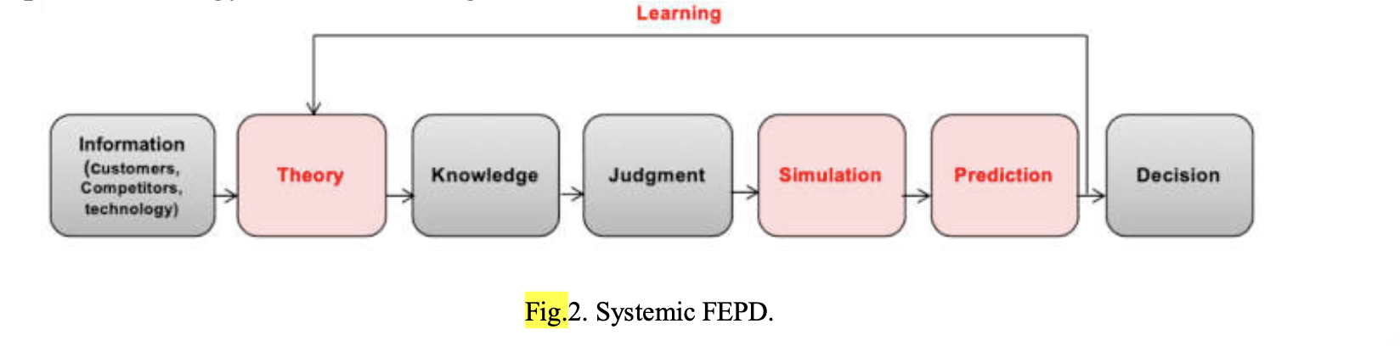
Proposition and model
Simulation: technique for understanding and predicting the behaviour of a system (extrapolation of new information using simulation )
Prediction: rigorous extrapolation of new information from existing information
Proposition: systems-thinking and predictive learning can reduce the uncertainty of the front-end and drive customer value creation in product development.

Slide 12
Simulation
Vapnik and Izmailov proposed using the intelligence of a human to accelerate statistical learning. A teacher provides privileged information - explanations, comments and metaphors. They propose using both data and statistical invariants to drive learning.
An expert (teacher) helps to construct statistical invariants latent in the problem. Based on their knowledge and experience, experts offer “shortcuts”, called predicates. Instead of initializing from a blank sheet of paper, the procedure starts by building on the expert’s wisdom.
The difference between invariants and features is that increasing invariants leads to more accurate predictions while the opposite is true for an increase in features, in this case requiring more training data.

Slide 13
Simulation - Experiment
For the experiment Brazilian automobile market segment was chosen
Customer data collection started with semi-structured interviews and “storytelling”.
Six SUV owners were surveyed (three interviews, three storytelling).
For about an hour each (predesigned script)
Three main concepts chosen
novelty, brand and price perception
Market share was chosen as the product competitiveness indicator
Sales data (vehicle registrations) were collected from the FENABRAVE
The seventeen most representative products were selected for monthly sales figures from January 2013 to December 2018.
Market share is the target value y, to be compared to estimated value y-prime for calculating errors (residuals) in the functions.

Slide 14

Simulation - Experiment
To synthesize the sample vectors, each product was evaluated according to the sixteen attributes
For this small-scale experiment, reviews from a specialized automobile magazine were used as a proxy for part of the “expert knowledge and judgment”.
A scale from one to five was used to evaluate attributes. Small SUV market share between 2013 and 2018 has ranged from about 0.002 to 0.029. For normalization, they were scaled by a factor of 200 to bring them close to the independent variable x range.
Every concept feature must be clearly defined (e.g. “economy” means fuel autonomy in kilometers per liter, split between 70% of urban and 30% of road use;
X – feature variable
X* - expert’s privileged information
A – variable parameter weight (calculated by the algorithm)

Slide 15
Simulation - Experiment
In the process, 765 vector samples with sixteen independent feature variables (concept attributes) and target dependent values were synthesized.
They were split in a 80:10:10 proportion among training, test and validation sets (they yielded slightly better performance than the default 70:15:15).
In the experiment, architectures ranging from p/2 to 2p nodes (8, 10, 12, 16, 20, 30) were tried, yielding correlations between 0.89 and 0.95 - the best result was achieved with ten units.
The hidden layer was activated by a hyperbolic tangent function g(z) = tanh(z). Target values are activated by the ReLU (rectified linear unit) function f = max (0, x).
The hidden layer was activated by a hyperbolic tangent function g(z) = tanh(z). Target values are activated by the ReLU (rectified linear unit) function f = max (0, x).

Slide 16
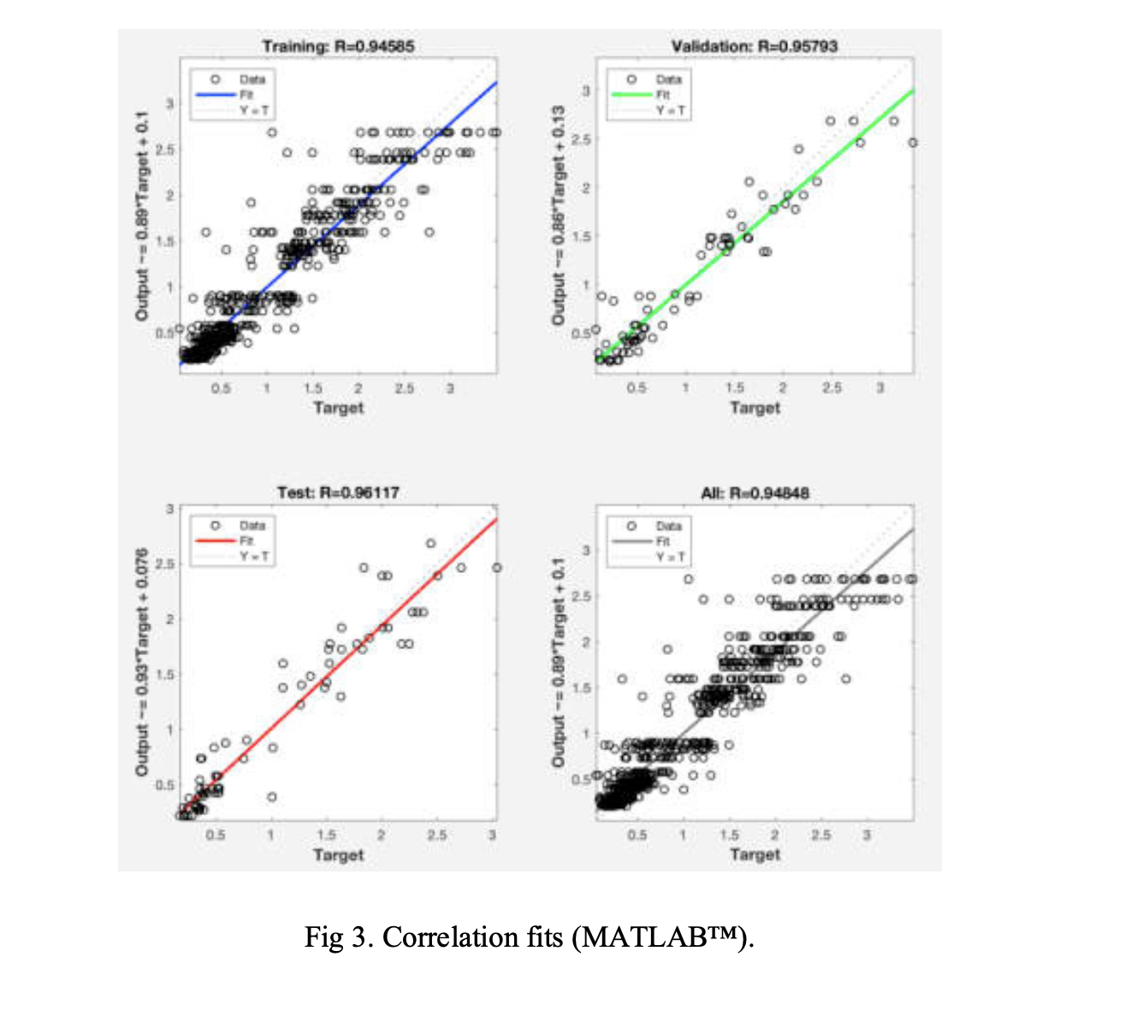
Results
The quality of result in a computer simulation is determined by its optimality – the extent a result achieved is the best possible;
The experiment yielded overall correlation coefficient R = 0.9485, after 15 epochs of 1,500 iterations. The correlation R for testing was 0.9612 and for validation, 0.9579.
It was a small-scale experiment, with sixteen independent variables, 765 samples and a relatively coarse evaluation scale with discreet values.

Slide 17
Conclusion
This article tackles a shortfall in the FEPD and suggests a systems approach supported by predictive learning.
The human expert is an active participant in the learning process, neither a mere “guesser” nor just a data provider.
Machine learning extracts relationships that are difficult to map mentally or heuristically, but usually needs large amounts of training data.
The proposed model is an extension of substantive existing literature. It contributes by offering a holistic problem-solving framework, integrating both systems thinking and statistical learning, to explain and to predict in the FEPD.
An artificial neural network was chosen as the simulation algorithm. However, that does not mean other tools - such as SVMs (support vector machines) - could not be equally or more effective.

Slide 18
THANK YOU!

